Slide 1
IANA Stewardship Transition and the Asia Pacific Community
Izumi Aizu, Sivasubramanian M., Kuo-Wei Wu
APrIGF New Delhi meeting
August 5th, 2014

Slide 2
Process for this session
Briefing “what the purpose and rule” (3 minutes)
Topics collect from floor (<5 minutes)
Please name a topic (should be few words < 5) or two (no more than two each person), such as timeline, process,…
Please don’t repeat topic which is raised by other
No more than 6 topics
Comments on the topics (75 minutes)
Prioritize the topics in 2 minutes (please show hands)
One topic at a time, and 12 minutes (the most) for each topic
Not try to debate viewpoints, but collect viewpoints for CG to consider
90 seconds comment per person

Slide 3
The U.S. Government’s Announcement
On 14 March 2014, the U.S. Government (USG) announced its intent to transition its stewardship of the IANA functions to the global multistakeholder community
As the first step, it asked ICANN to convene global stakeholders to develop a proposal to transition the current role played by the US
ICANN was asked to serve as a convener based on its role as the IANA functions administrator (since 1998) and the global coordinator for the Internet's Domain Name System (DNS)
The multistakeholder community has set the policies implemented by ICANN for more than 15 years

Slide 4
Transition Proposal’s Guiding Principles
NTIA has communicated to ICANN that the transition proposal must have broad community support and address the following four principles:
Support and enhance the multistakeholder model
Maintain the security, stability, and resiliency of the Internet DNS
Meet the needs and expectation of the global customers and partners of the IANA services
Maintain the openness of the Internet
NTIA also specified that it will not accept a proposal that replaces the NTIA role with a government-led or an intergovernmental organization solution.

Slide 5
What are the IANA Functions?
The IANA functions involve the coordination of unique Internet identifiers, including:
Maintenance of the protocol parameter registries on behalf of the IETF
Allocation of Internet Numbers in cooperation with the Regional Internet Registries
Management of the .ARPA and .INT domains
Administrative responsibilities of the DNS root zone
Coordination of root zone management

Slide 6
As of 29 March 2014:
ICANN launched a multistakeholder (global in scope) process at the ICANN 49 Meeting in Singapore.
Based on initial input, from 8 April – 8 May 2014, ICANN issued a call for public comment on the draft principles, mechanisms and process to develop a proposal (translated into 5 official UN languages, plus Portuguese).
Community response to draft process:
700 email exchanges
60 process contributions
Participation from global stakeholders, including government, private sector, civil society, technical, academic community and end users
Submissions made in different languages

Slide 7
As of 24 April 2014:
A special session was held at NETmundial conference in Brazil.
Over 1,000 attendees from 116 countries
1168 remote participants from 33 worldwide remote hubs in 23 countries
Participation from global stakeholders, including government, private sector, civil society, technical, academic community and end users
ICANN’s GSE team and partner organizations have been and continue to engage in a series of regional dialogues with global stakeholders.

Slide 8
As of 6 June 2014:
Informed by input on the draft process and subsequent dialogues, the Process to Develop a Proposal and Next Steps was posted online, echoing community feedback.
Renamed the proposed "Steering Group" to "Coordination Group”
No role for the Chair of the ICANN Board and Chair of the GAC in selection of members
Direct representation
Eliminated the distinction between affected and non-affected parties
Revised composition to ensure greater balance and representation, including indirect stakeholders non-prescriptive about the roles and responsibilities of the Coordination Group
Coordination Group will establish its own working methods and modes of operation
ICANN maintains neutral role as convener and facilitator of process
Coordination Group encouraged to adhere to diversity standards as they undergo internal selection processes

Slide 9
As of 26 June 2014
ICANN held a special community run session entitled Transition of NTIA’s Stewardship of IANA Functions at the ICANN 50 Meeting in London.
Provided the community the opportunity to discuss all elements of the transition process.
Agenda:
Role of communities vs. the Coordination Group
Engaging participants outside of the traditional ICANN, IETF, and RIR participants
Defined success criteria
Relationship of the work on Accountability and NTIA Transition
Open Discussion
Sessions engaged in dialogue and received comments from a live-streaming chat room and over a dozen interactive hubs around the world.

Slide 10
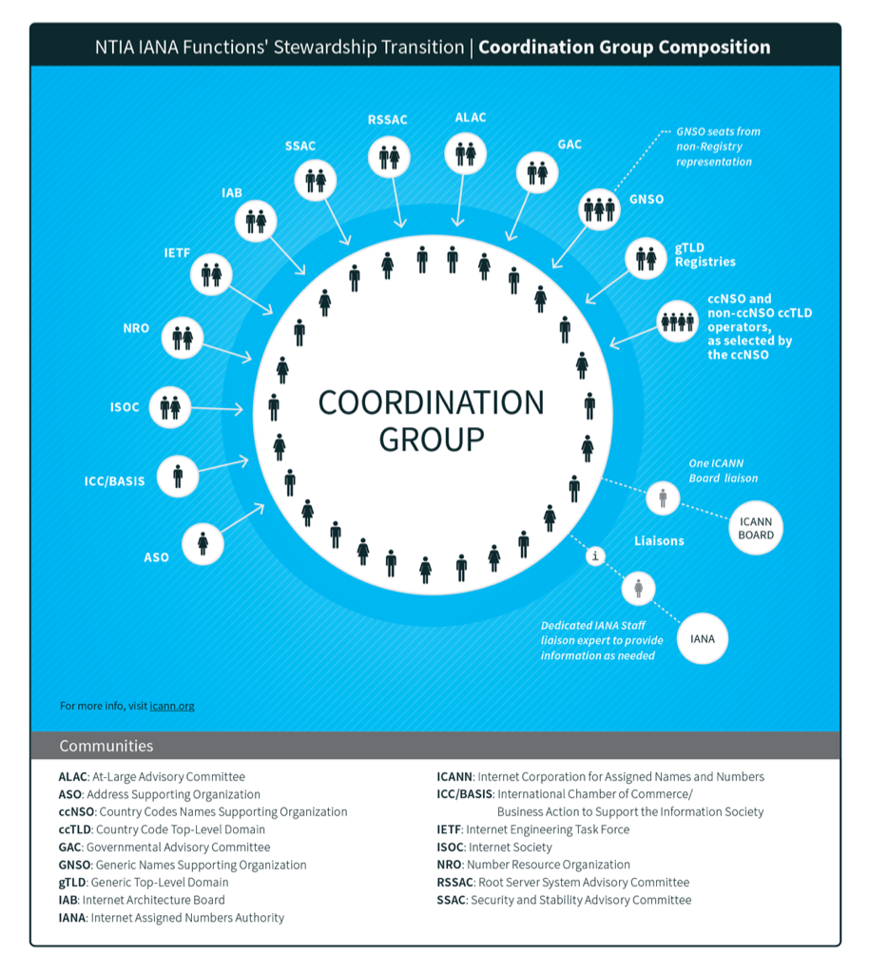

Slide 11
As of 3 July 2014
Composition of IANA Stewardship Transition Coordination Group (ICG) announced.
*17 July 2014 – The ICG accepted the GAC’s request to increase the number of GAC representatives in the ICG from two to five.
Community | Member Name
ALAC | Mohamed El Bashir
ALAC | Jean-Jacques Subrenat
ASO | Hartmut Glaser
ccNSO | Xiaodong Lee
ccNSO | Mary Uduma
ccNSO | Keith Davidson
ccNSO | Martin Boyle
GAC* | Manal Ismail
GAC* | Heather Dryden
GAC* | Kavouss Arasteh
GAC* | Michael Niebel
GAC* | Jandyr Ferreira dos Santos
GNSO | Wolf-Ulrich Knoben
GNSO | Milton Mueller
GNSO | James Bladel
gTLD Registries | Keith Drazek
Community | Member Name
gTLD Registries | Jon Nevett
ICC/Basis | Joseph Alhadeff
IAB | Russ Housley
IAB | Lynn St Amour
IETF | Jari Arkko
IETF | Alissa Cooper
ISOC | Narelle Clark
ISOC | Demi Getschko
NRO | Adiel Akplogan
NRO | Paul Wilson
RSSAC | Daniel Karrenberg
RSSAC | Lars-Johan Liman
SSAC | Patrik Fälström
SSAC | Russ Mundy
ICANN Board Liaison | Kuo-Wei Wu
IANA Staff Expert | Elise Gerich

Slide 12
As of 18 July 2014
The ICG met for the first time on 17-18 July 2014 in London, United Kingdom.
In this first face-to-face meeting, the ICG:
Developed a proposed charter and scope for its future work in support of the community’s development of a proposal
Conducted an initial discussion of a draft timeline for development of the transition proposal
Worked on its internal organization, communications needs and participation processes
20 Members of the ICG attended in-person, one of whom was a GAC interim representative, and 2 liaisons; 5 participated remotely; 2 were unable to attend
Resources from the ICG meeting, including the meeting agenda, transcripts and audio translations can be found here: https://www.icann.org/resources/pages/coordination-group-resources-2014-07-18-en

Slide 13
One topic at a time
90 seconds comment per person
Please line up mic for each topic
Don’t comment for different topic at a time
Give others a chance to comment
Don’t repeat when someone already did

Slide 14
Thank You!

