Slide 1
Participation at ICANN
2014.08.05 | New Delhi

Slide 2
















15 Years in the Domain Industry…
1999-2003
2003-2006
2006-…
30 Members:
22 ccTLD
Members
Supporting
30 new gTLD
Applications

Slide 3
August 1999 Santiago
Nii Quaynor, chair of the then DNSO General Assembly

Slide 4
1999-2001: ccTLD Constituency
From DNSO to ccNSO

Slide 5
GNSO
2001-2003: Registrar Constituency
2005-2009: GNSO Council
2009-2014: JIG & IRD

Slide 6
ALAC / At-Large
2002-2007: APRLAO (ISOC HK)
2010-2012: ALAC (from APRALO)
2010-2014: IDN Liaison

Slide 7
Challenges for Participation
Costs & Return on Investments
Volume of Activity
Language & Timezone
Culture & Sociopolitical Environments

Slide 8

DotAsia as a not-for-profit organisation with a mandate to promote Internet development and adoption in Asia.

Slide 9
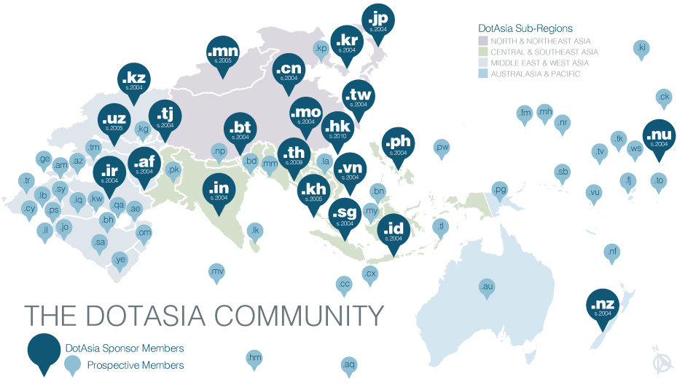
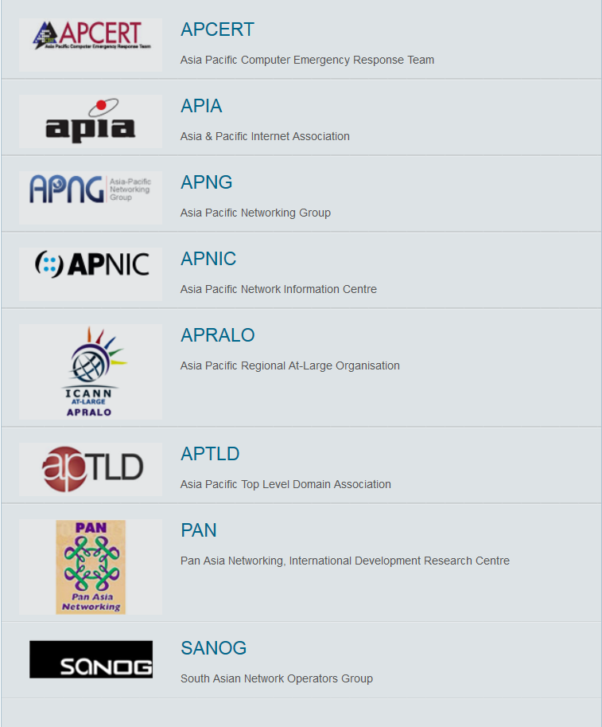

Slide 10
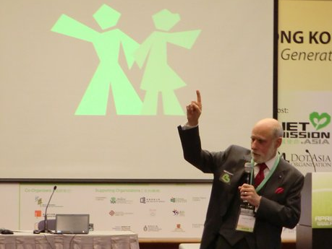

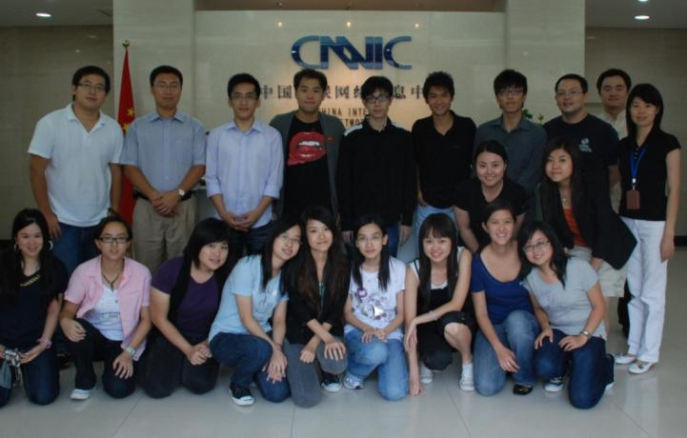
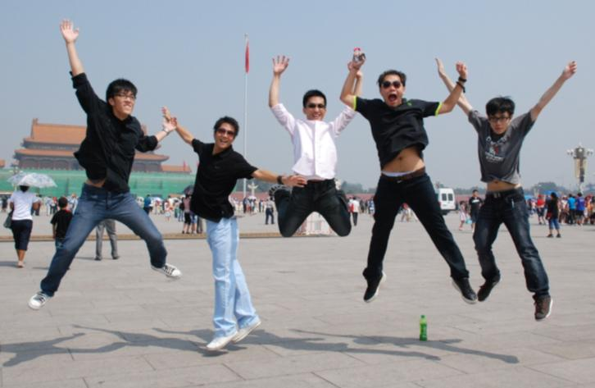
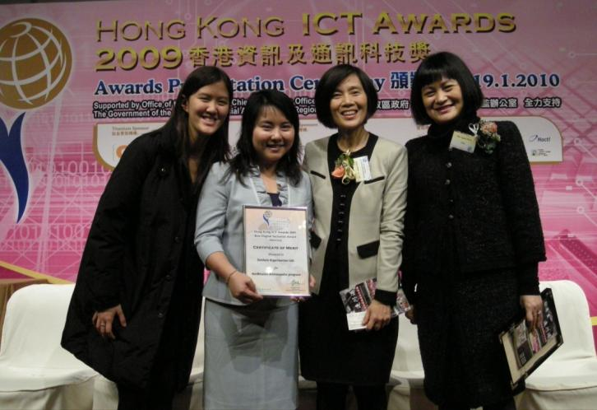
NetMission.Asia

Slide 11
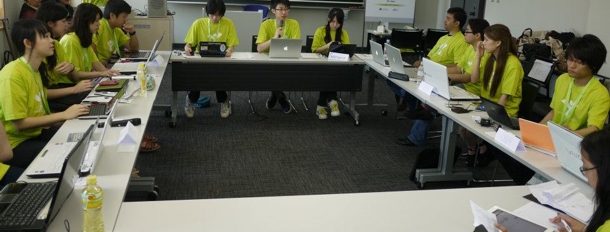

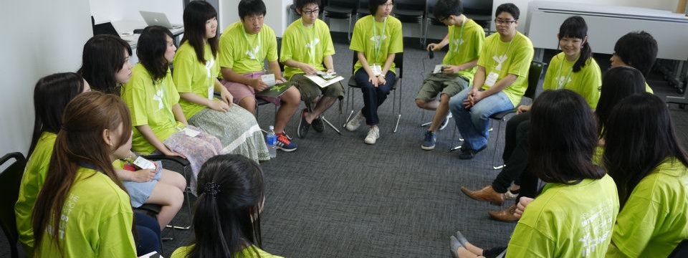

Slide 12




Slide 13


AsianFilmAwards.Asia
The Asian Oscars

Slide 14
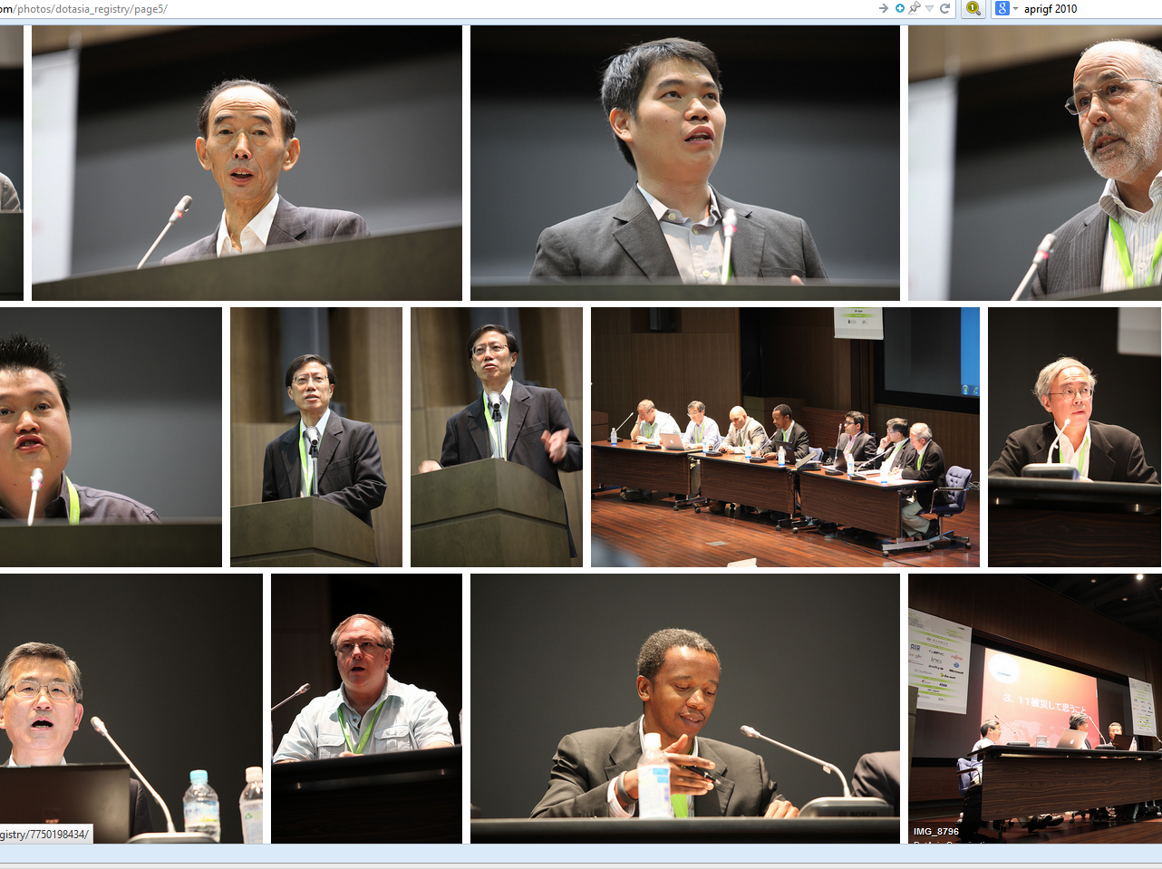

Asia Pacific Regional Internet Governance Forum (APrIGF)

Slide 15
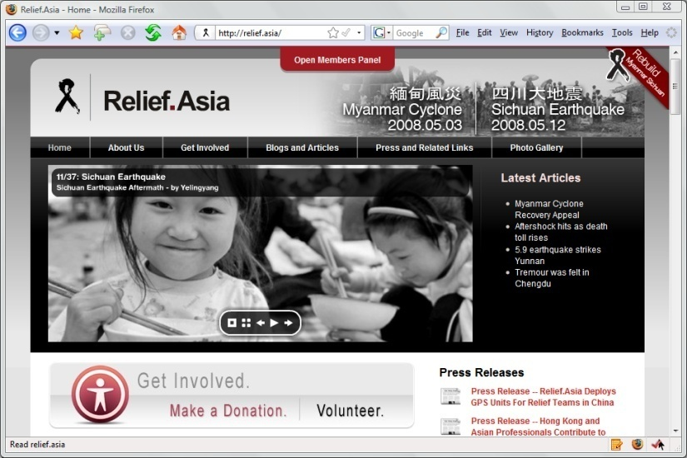
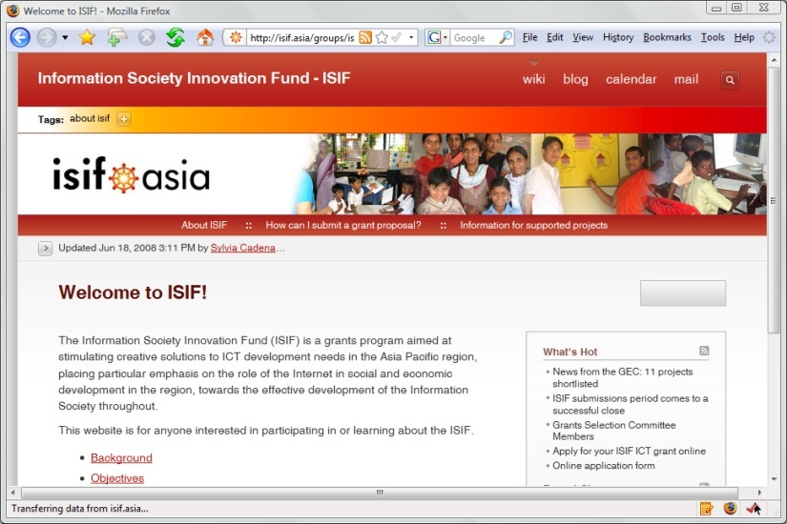
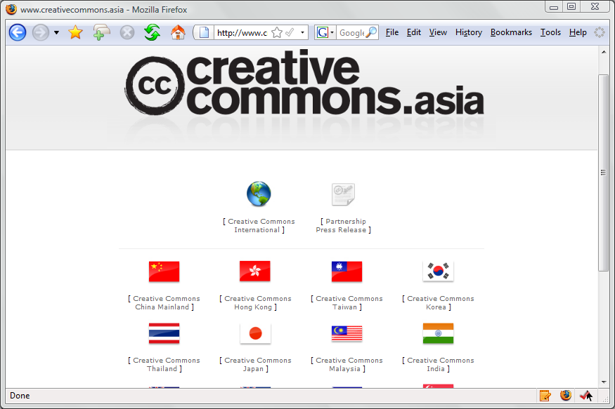
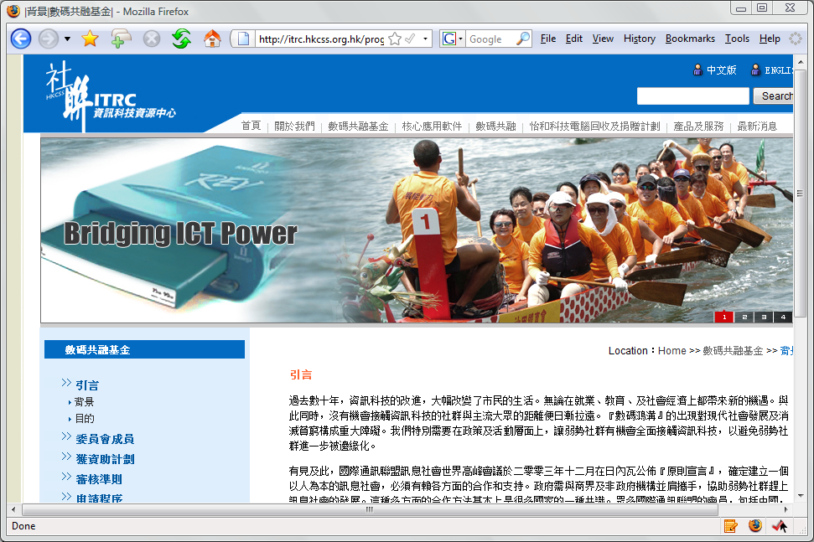
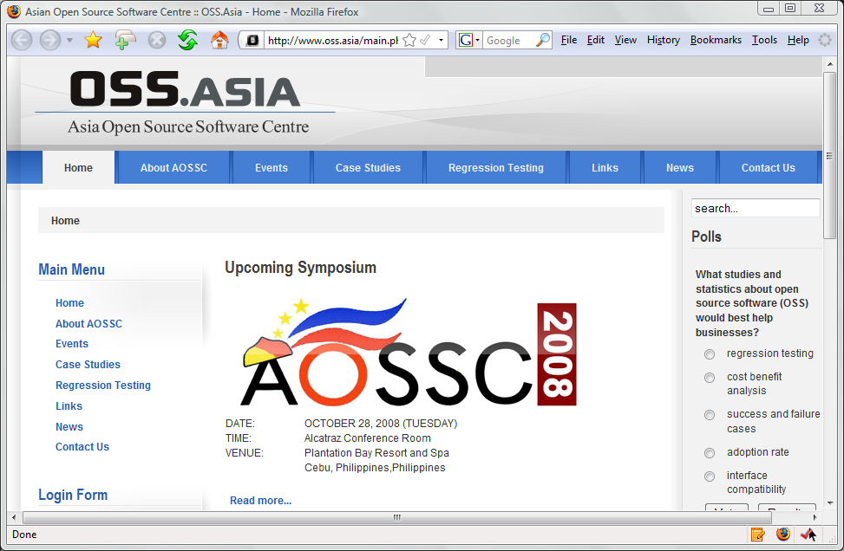
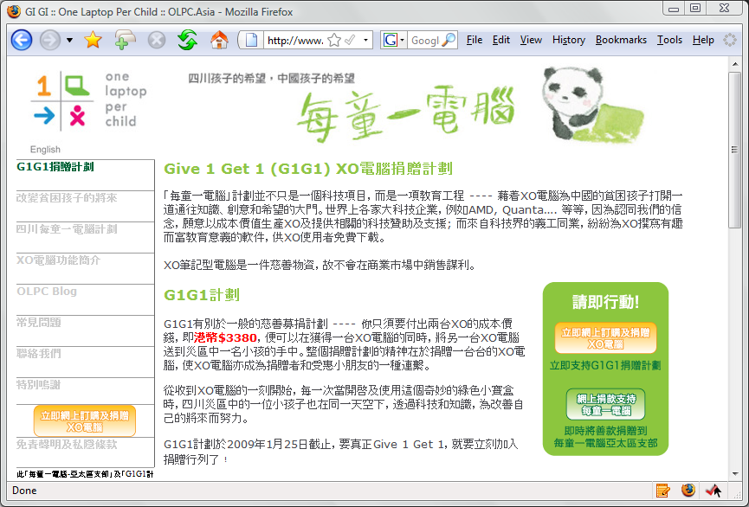

Every .Asia Domain
Contributes to Internet Development in Asia
Edmon Chung <edmon@registry.asia>

